Slide 1


Analysis of Sales Data
Data - Driven Insights
Presented by Mohd Amish

Slide 2

Project Overview
In this project, I performed a comprehensive data analysis on sales data using Microsoft Excel. The aim was to extract meaningful insights and present the findings in a clear and effective manner. Through this analysis, various key performance indicators were identified and visualized, helping to understand trends, patterns, and areas for improvement in the sales performance. The project involved several steps including data cleaning, analysis, visualization, and presentation.

Slide 3

Tools and Methodology used in the Project
Microsoft Excel:
Primary tool for data analysis and visualization.
Utilized features such as Pivot Tables, Charts, and Functions for comprehensive data analysis.
Microsoft PowerPoint:
Used for creating the presentation to communicate findings effectively.

Slide 4


Problem Statements
What was the value of catalog sales for London in the first quarter?
What percent of the total annual sales were Tokyo Web sales in the fourth quarter?
What percent of Sydney's annual sales was its Catalog sales?
What was the value of catalog sales for London in January and give details of the transactions?
What was the value of Camel saddle sales for Paris by quarter?
How many Elephant polo sticks were sold in New York in each month?

Slide 5

Solutions
01.
What was the value of catalog sales for London in the first quarter?
= 7810
02.
What percent of the total annual sales were Tokyo Web sales in the fourth quarter?
= 0.01%

Slide 6
Solutions
03.
What percent of Sydney's annual sales was its Catalog sales?
=18.24%
What was the value of catalog sales for London in January and give details of the transactions?
= 411
Transaction Details:
04.
Transid WHEN WHERE WHAT HOW QUANTITY REVENUE 277 09-01-2002 London Hammock Catalog 5 275
114 09-01-2002 London Hat - polar explorer Catalog 4 136

Slide 7
Solutions
05.
What was the value of Camel saddle sales for Paris by quarter?
Q1- 4186 Q2- 14950 Q3-24518 Q4-8372
How many Elephant polo sticks were sold in New York in each month?
Mar 5
Apr 7
May 2
Jul 1
Aug 5
Sep 2
Dec 7
06.

Slide 8
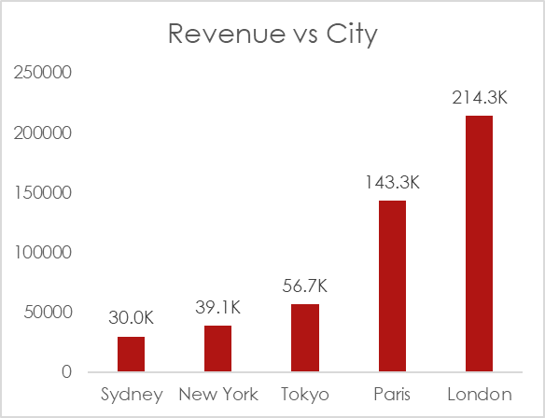
Revenue vs City
Insight: This chart highlights the total revenue generated by each city.
Key Findings: London recorded the highest monthly revenue with a peak of $214,000, whereas Sydney had the lowest at $30,000.

Slide 9
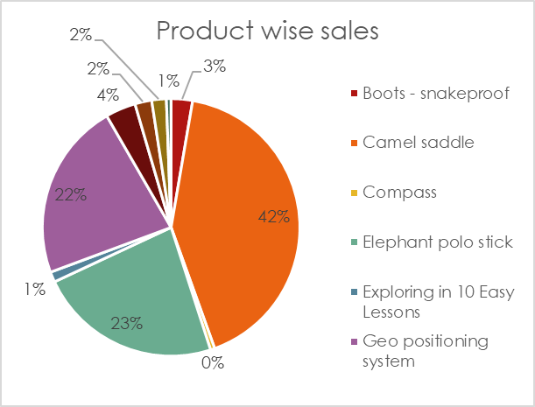
Product-Wise Sales
Insight: The pie chart illustrates the proportion of sales for each product.
Key Findings: The Camel Saddle emerged as the most popular product, accounting for approximately 42% of sales. This is followed by the Elephant Polo Stick at 23% and the Geo Positioning System at 22%.

Slide 10
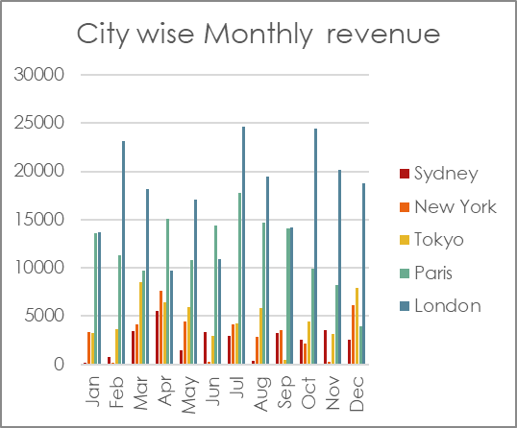
City Wise Monthly Revenue
Insight: The chart displays the revenue generated in each city on a monthly basis.
Key Findings: London leads in total revenue generation in the month of July, underscoring its significance as a key market, while Sydney shows potential for growth.

Slide 11
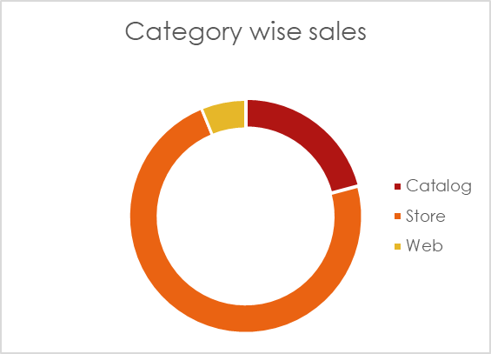
Category-Wise Sales
Insight: This chart presents the sales distribution across different sales channels.
Key Findings: The majority of sales (73%) occurred through the store, indicating a strong preference for in-person shopping. Catalog sales accounted for 21%, and web sales were minimal at 3%.

Slide 12
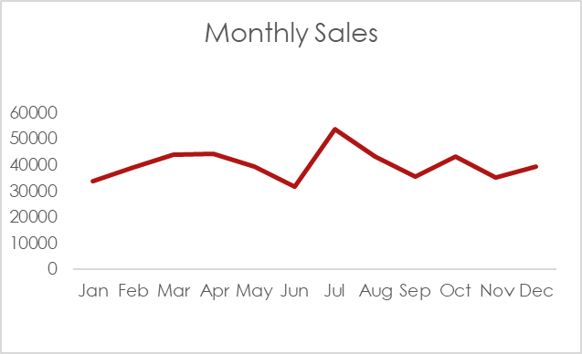
Monthly Sales
Insight: The line chart tracks the sales trends over the months.
Key Findings: July experienced the highest sales, marking it as the peak sales month, while June had the lowest sales, indicating potential seasonality in purchasing behaviour.

Slide 13
Conclusion
London has the highest sales, indicating a strong market presence.
Sydney has the lowest sales, presenting a growth opportunity.
Camel Saddle is the best-selling product, indicating high demand.
In-store sales dominate, reflecting customer preference for physical shopping.
July is the peak sales month, suggesting seasonal trends.

Slide 14
Recommendations
Increase marketing efforts and inventory for London.
Develop targeted promotions to boost sales in Sydney.
Stock and promote the top-selling Camel Saddle.
Enhance in-store customer experiences and loyalty programs.
Invest in website usability and digital marketing to boost web sales.

Slide 15

Presented by Mohd Amish
Thank you very much!

